Slide 1
Music Therapy: An Innovative Approach to Working with Special Needs Adopted Children
David Hussey, PhD
Case Western Reserve University, Cleveland, Ohio
Anne M. Reed NMT, MT-BC
Beech Brook, Cleveland, Ohio
Create the Next Wave: American Adoption Congress and Adoption Network Conference, April 12, 2013
The music therapy program at Beech Brook is generously funded by a grant from the Kulas Foundation, Cleveland, Ohio

Slide 2
Why Music Therapy?
Inherently non threatening
It is an inviting medium for children
Offers a safe environment to explore feelings, behaviors, and therapeutic issues
Helps children build self- image
Help children address issues of mourning and abandonment
Help children develop pro-social skills and improve social reciprocity.

Slide 3
Research Findings and Clinical Implications for Special Needs Adopted Children: Selected Results from DHHS Study #90-CO-0960

Slide 4
Study Design
Table 1. Study Design
Cohort I 1976-1996 N=202 Retrospective Comprehensive Chart Review & Data Collection | Cohort II 1997-2002 N=258 Retrospective Comprehensive Chart Review & Data Collection + some DSMD instrumentation | Cohort III 2002-2005 N=104 Prospective Referral → Placement (T1) Comprehensive Retrospective Chart Review & Data Collection → Finalization (T2) → 90 day follow-up (T3) → 1-year follow-up (T4) → 2-year follow-up (T5)
Notes:
Cohort 1. Spaulding adoptive placement dates for Cohort 1 range from 5/9/77 to 12/15/96, although the children’s permanent custody dates go as far back as 12/7/62.
Cohort 2. Permanent custody dates range as far back as 8/15/1989.
A mixed retrospective/prospective design was used to examine the descriptive characteristics of three cohorts of consecutively referred special needs adoption children linked by a common core of client, family, and system variables. The retrospective subset includes two cohorts totaling 460 children; the prospective subset consists of a single cohort of 104 children. For purposes of this paper, only the descriptive characteristics of the three cohort children and their biological parents are examined. The study sample ranges from infants to teens, and includes foster-to-adopt as well as some of the hardest-to-place children residing in residential treatment environments.
Cohort 1 (N=202; 1977-1996): Cohort 1 spans the beginning of the special needs adoption movement to the implementation of the Adoption and Safe Families Act (ASFA). Spaulding adoptive placement dates range from 5/9/77 to 12/15/96, although the children’s permanent custody dates go as far back as 12/7/62.
Cohort 2 (N=258; 1997-2002): Cohort 2 adoptive placements range from 2/22/97 to 4/17/2002, coinciding with the implementation of the Adoption and Safe Families Act. Permanent custody dates range as far back as 8/15/1989. Generally, the chart review information and documentation was considerably better than the documentation available for the earlier Cohort 1 children. This data set includes 496 variables.
Cohort 3 (N=104; 2002-2005): While Cohort 3 utilizes the same chart review variables as Cohort 2, it also incorporates a prospective design, however, that is not the focus of this paper’s descriptive analysis. Over eighty-six percent (104/120) of the consecutively referred adoptive cases placed agreed to be enrolled in the study (i.e., 16 families declined); 96.6% (84/87) of cases eligible to participate at finalization completed assessments.
Cohort 3. Over eighty-five percent (105/120) of adoptive cases placed agreed to be enrolled in the study; 96.6% (84/87) of cases eligible to participate at finalization completed assessments; 96.2% (76/79) of cases eligible to participate at 90-day post finalization completed assessments; and 94.4% (51/54) of cases eligible to participate at 12-month follow-up completed assessments,
A mixed retrospective/prospective design was used to examine the descriptive characteristics of three cohorts of consecutively referred special needs adoption children linked by a common core of client, family, and system variables. The retrospective subset includes two cohorts totaling 460 children; the prospective subset consists of a single cohort of 104 children. For purposes of this paper, only the descriptive characteristics of the three cohort children and their biological parents are examined. The study sample ranges from infants to teens, and includes foster-to-adopt as well as some of the hardest-to-place children residing in residential treatment environments.
Cohort 1 (N=202; 1977-1996): Cohort 1 spans the beginning of the special needs adoption movement to the implementation of the Adoption and Safe Families Act (ASFA). Spaulding adoptive placement dates range from 5/9/77 to 12/15/96, although the children’s permanent custody dates go as far back as 12/7/62.
Cohort 2 (N=258; 1997-2002): Cohort 2 adoptive placements range from 2/22/97 to 4/17/2002, coinciding with the implementation of the Adoption and Safe Families Act. Permanent custody dates range as far back as 8/15/1989. Generally, the chart review information and documentation was considerably better than the documentation available for the earlier Cohort 1 children. This data set includes 496 variables.
Cohort 3 (N=104; 2002-2005): While Cohort 3 utilizes the same chart review variables as Cohort 2, it also incorporates a prospective design, however, that is not the focus of this paper’s descriptive analysis. Over eighty-six percent (104/120) of the consecutively referred adoptive cases placed agreed to be enrolled in the study (i.e., 16 families declined); 96.6% (84/87) of cases eligible to participate at finalization completed assessments.

Slide 5
Mean & Total Number of Placements
Notes:
AFCARS 2006: A consistent finding of the Child Welfare Outcomes Reports is that, although States are fairly successful in achieving placement stability for children in foster care for less than 12 months, the percentage of children who have placement stability declines considerably the longer the children are in foster care. There is an ongoing need for improvement in this area, as indicated by the fact that 54 percent of States exhibited a decline in performance from 2003 to 2006 with regard to placement stability for children in foster care for 24 months or longer.

Slide 6
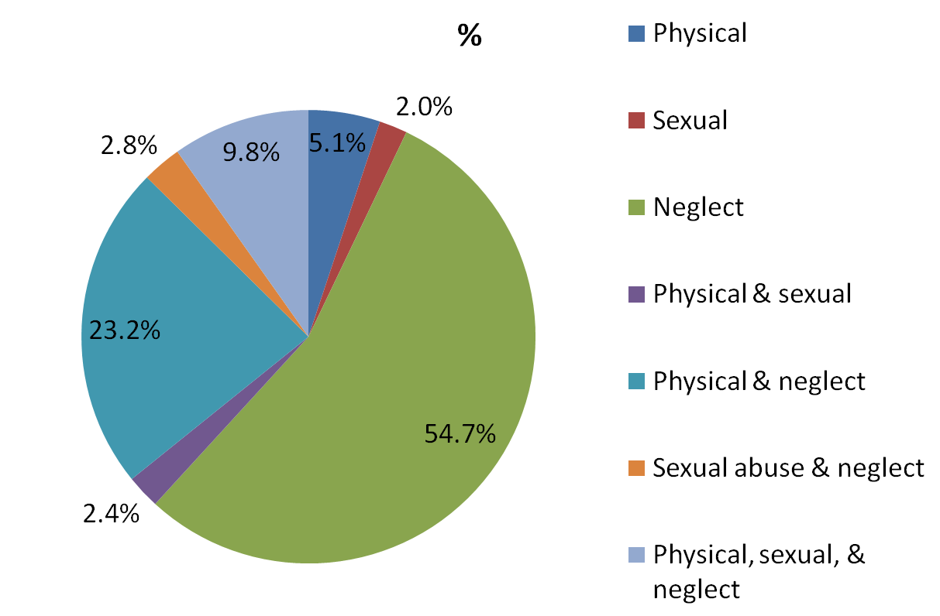
DHHS Study: Maltreatment History Prior to First Out-of-Home Placement (n = 254)
Notes:
Patterns of multiple abuse
Significant interpersonal losses
Multiple moves and attachment disruptions
Long pathways to permanency
Academic & special education Issues: 34.8% of clients had a documented disability, delay, or handicap
*Out of 362 cases, 59 cases (16.3%) had no history of child maltreatment prior to the first out-of-home placement. In another 49 cases (16.3%), there was incomplete (n = 26, 7.1%), missing (n = 15, 4.1%), or allegation data (n = 8, 2.2%) that did meet chart review standards for documented maltreatment.
A rigorous and comprehensive chart review of 362 consecutively referred special needs adoption cases from 1997 to 2005 provides one of the most in-depth profiles of both special needs adoption children and their biological mothers to date.
A mixed retrospective/prospective design (258 retrospective and 104 prospective) was used to examine the profile and descriptive characteristics of 361 consecutively referred special needs adoption children linked by a common core of over 250 client, family, and system variables. The adoptive placements range from 2/22/97 to 4/17/2002, coinciding with the implementation of the Adoption and Safe Families Act.

Slide 7
Death of a Parent, Sibling, Caretaker, or Significant Other
Relationship | Frequency | Percent
Biological mother | 13 | 3.6%
Biological father | 14 | 3.9%
Biological sibling | 20 | 5.5%
Other biological relative | 5 | 1.4%
Foster caregiver | 7 | 1.9%
Adoptive caregiver | 1 | 0.3%
Other | 3 | 0.8%
Multiple | 5 | 1.4%
Total | 68 | 18.8%
Notes:
*Significant others and other biological relatives included grandparents, alleged grandparents who children lived with, and a foster mother’s biological daughter.

Slide 8
Immediate Family Member Incarcerated
Relationship | Frequency | Percent
Biological Mother | 60 | 16.9%
Biological Father | 60 | 16.6%
Biological Mother & Biological Father | 36 | 9.9%
Biological Parent and Sibling | 1 | 0.3%
Total | 158 | 43.6%

Slide 9
Characteristics of Biological Mothers
Variable | Frequency | Percent
History of prostitution | 22 | 6.1%
History of drug or alcohol problems | 275 | 76.0%
History of domestic violence | 66 | 18.2%
History of homelessness | 147 | 40.6%
History of mental disorder | 141 | 38.9%
History of incarceration | 97 | 26.8%

Slide 10
Case Example: Attachment Disruptions & Permanency Pathways
Prior to Carol's admission to Beech Brook in May 1994 at age 9, Carol had 11 previous out-of-placements, and spent 2,266 days in placements.
Carol had a full scale IQ of 62, experienced severe and chronic physical abuse, neglect, and sexual abuse, and her behavior was violent, hallucinatory, and highly sexualized.
Carol was first removed from her home at 2.5 years-of-age and her placement chronology includes: foster care → residential treatment → foster care → residential treatment→ adoption→ foster care→ foster care→ adoption→ foster care→ psychiatric hospitalization→ foster care → Beech Brook.
Her Beech Brook treatment path and corresponding Devereux Scale of Mental Disorders (DSMD) psychiatric ratings are presented below. The DSMD clinical cut-off score for distinguishing clinical from nonclinical populations is 60.
Notes:
Carol’s last adoptive placement disrupted after she and her sister put drano in their adoptive mother’s coffee.

Slide 11
 |  |  |  |  |  |  |  | Carol's Beech Brook Treatment Path
YEAR | 1994 |  |  |  |  |  |  |  | 1995 |  |  |  |  |  |  |  |  |  |  |  | 1996
MONTH | 5 | 6 | 7 | 8 | 9 | 10 | 11 | 12 | 1 | 2 | 3 | 4 | 5 | 6 | 7 | 8 | 9 | 10 | 11 | 12 | 1 | 2 | 3 | 4 | 5 | 6 | 7 | 8
Residential Treatment
Individual Therapy
Music Therapy
Life Book Group
Sibling Music Therapy
Cottage Visits with Potential Adoptive Mother
Bonding Therapy
Bonding Time & Home Visits
Day Treatment & Adoption Placement
Experiential Group
Adoption Finalization

Slide 12
Music Therapy Interventions
Music Attention Control Training
Music Psychotherapy and Counseling
Social competence training
Following rules, understanding personal boundaries
Affect behavior training
Cognitive reorientation
Mood induction and vectoring

Slide 13
Therapeutic Music Applications
Instrument Choices
An opportunity for the child to select desired instrument(s).
Interactive singing
The recitation of simple chants which provides opportunities to practice cooperation with others in verbal and non-verbal (musical) ways in a give-and-take manner
Interactive instrument playing
The use of playing of various musical instruments to promote social interaction or communication between the therapist and client or between clients and/or peers
Also promotes self awareness and awareness of their relationship with the other person who is playing along with them. Call and response tasks promote reciprocity
Concept Songs
The use of specific song lyrics and form to promote mastery of one or more language or academic concepts (applied also to learning social skills).
Discussion Questions and Themes
Based on each experiential music therapy application and allow children to state their thoughts and opinions without requiring self-disclosure.
Notes:
Instrumental improvisation
Creative, “on-the-spot” instrumental composition and performance within metric, rhythmic, form, melodic, harmonic, or timbre guidelines
Movement improvisation
Creative, “on-the-spot” movement composition and performance within metric, rhythmic, form, melodic, harmonic, or timbre guidelines
Musical response to cue
A vocal or instrumental reply to either a melodic or lyric signal.
A signal can be a change in the melody, pitch, rhythm, amplitude of the music, or a specific word in the lyrics of a song

Slide 14
Music Therapy Applications
Song Writing
A technique in which the child contributes ideas for original lyrics or music in order to express feelings or enhance communication. Song writing enables the child to talk about feelings, experiences, desires, and may help the child to gain insight and problem-solve.
Instrumental Improvisation
Creative, “on-the-spot” instrumental composition and performance within metric, rhythmic, form, melodic, harmonic, or timbre guidelines.
Lyric Analysis/Interpretation
Techniques involving discussion of song lyrics, their content and their significance. Lyric analysis provides opportunity to empathize with another, share personal impressions/ feelings, discuss choices made by the person in the song and their ramifications, discuss related issues, and problem solve solutions.
Musical Instrument Instruction
A structured approach to teaching one or more basic components/ concepts of music, such as rhythm, melody, harmony, symbols, notation, dynamics, form, etc., in an adapted or traditional fashion. Instrument instruction also sets the occasion to practice skills at managing frustration and accepting adult instruction.

Slide 15
Age Adaptations
Developmentally Younger Children
Simple perception applications can be utilized focusing on sustained attention. (Listening for one auditory change stop/ go, loud /soft, fast /slow, or song 1/ song 2)
Music task can focus on imitation and exploration of skills the child may be lacking (discrimination of rhythms, discrimination of high sounds and low sounds)
More use of movement related applications that address attention, impulse control.
Teaching concrete steps to develop skills such as listening, and following directions

Slide 16
Age Adaptations
Developmentally older children
More complex perception applications can be utilized (such as responding to layered auditory information, including tempo/ volume or tempo/volume/speed combinations)
Musical demands can be increased to include higher expectations for rhythmic accuracy as well as memory for musical sequences
More complex match to sample tasks can be used with those children who can read
Begin reflection on thought processes and related feelings, verbal, and motor responses
Progress into other construct areas, such as Managing Negative Affect and Social Reciprocity

Slide 17
Music Therapy Applications
Improving Social Reciprocity- building and maintaining a relationship using positive social interactions.
Awareness and rapport
Listening/ following directions [knowing the rules]
Personal boundaries
Being kind/ controlling anger
Problem solving

Slide 18
Music Therapy Applications
Awareness and Rapport
Interactive Instrument Playing
Here family members can engage in music ensemble playing.
Structured versed Improvised
Structured playing would utilize charts [melodic and rhythmic] color, number, or word coded. Each member would have a part to play in the ensemble.
Improvised playing would utilize each persons inspiration to create a unique musical sound. Each person would have an instrument and would contribute a rhythm or melody generated by the individual yet synchronized and harmonized with the group as a whole
Notes:
Discuss individual and family applications
Example of “Arie” talk to everybody foster/ adopt mom provided information wrote a song
Demonstrate how you can re-write the song and then create a movement task using hoola hoops.
Reciprocal Drumming- intentionally enter the personal space of the other person, opportunity for them to practice coping skills

Slide 19
Music Therapy Applications
Awareness and Rapport
Song Writing
Take a structured ensemble and change the words to personalize them to the family
Favorite Things [sports, food, music, color, etc]
Things not liked [sports, food, music, color, etc]
Family Rules

Slide 20
Music Therapy Applications
Listening/ Following Directions
Music tasks designed in which the participant(s) listen for then respond to specified cues
Sound such as a whistle blowing, specific rhythm pattern, specific song or lyrics in a song “Boom Shake the Room, ” melodies the cue movement “Listen and Move” Steve and Greg, and different sections of the song “Beat It” Michael Jackson.
Children with attention deficits may require attention training as well.

Slide 21
Music Applications
Listening/ Following direction continued
Concept song teaching listening steps
“Stop Look and Listen” Ronna Kaplan
Use the song to cue the child’s listening skills
Fade music to words
Fade out words
Concept song to teach steps for following directions.
“Do what I’m told” Anne M. Reed
Any of the concept songs can be performed as an ensemble.

Slide 22
Music Therapy Applications
Personal Boundaries
Using interactive instrument playing, instrumental improvisation,
Concept songs about good touches and bad touches
Song writing about personal space and boundaries
Social Space [Common rooms]
Personal Space [ Individual rooms, belongings]
Intimate Space [physical interactions]
Music and movement- role play boundaries “You Can’t Touch This” by MC Hammer [hoola hoops], Paddle Drum Chants
Reciprocal Drumming (Interactive Instrument Playing)
Lyric Analysis/ Interpretation [Abuse histories]

Slide 23
Music Therapy Applications
Personal Boundaries Continued
India Arie- “Strength, Courage and Wisdom,” Beautiful Flower,” “There’s Hope,” “Wings of Forgiveness,” and “I Choose”
Destiny’s Child- “Story of Beauty” and “Survivor”
Christina Aguilera- “Soar,” “Fighter,” “Reflection,”
“I Will Get There” by Boyz II Men
“I Can Be” by Taio Cruz
“Perfect” by Pink (there is a reference to drinking a beer)

Slide 24
Music Therapy Applications
Being nice/ managing anger
Teaching how to appropriately communicate feelings and manage anger aggression
Song Writing about feelings, feeling trigger- “Express Yourself.”
Song Writing about family rules, expectations, daily schedules etc.
Music applications that practice relaxation techniques such as breathing and counting- “Beat It” by Michael Jackson
Create a relaxation CD
Notes:
Download the song “Express Yourself” both regular and instrumental versions demonstrate how to do the song writing
Demonstrate drumming and choir chimes angry/ verses relaxed

Slide 25
Music Therapy Applications
Problem Solving
Concept song teaching the problem solving steps
Discussion question and themes in which you apply the steps to social scenarios
Instrument Instruction- presents learning challenges and ways
Create problems in the music setting in which they have to apply the skill components

Slide 26
Conclusion
Music therapy has enormous range and versatility to address needs of special needs adopted children
Due to the nonthreatening and reinforcing nature of music, it may be ideally suited to work on social reciprocity.

Slide 27
Additional Resources
Betts, D. (Ed.). (2003) Creative arts therapies approaches in adoption and foster care: Contemporary strategies for working with individuals and families. Springfield, IL: Charles C. Thomas

